Slide 1
Unit -API Testing
Raghu Prasad K S
www.kaushalya.tech
9845547471

Slide 2
Agenda
What is API Testing ?
API Testing using postman

Slide 3
What is API Testing
API testing, or application programming interface testing, is a type of software testing that focuses on the testing of individual API methods and the interactions between different APIs. This type of testing is typically performed at the integration level, after unit testing is completed, and before user interface testing begins. It is used to validate that the API behaves correctly and that it meets the requirements of the system.
API testing can be performed manually or using automated testing tools. Some common tasks that are performed during API testing include:
Testing the functionality of the API to ensure it behaves as expected
Verifying that the API returns the correct response for different input values Checking for error handling and validation of input
Testing for security vulnerabilities
Checking for performance and scalability of the API
API testing is important because it ensures that the different components of a system can communicate with each other correctly and that the system can handle a large volume of requests.
It is also used to ensure that the API is compatible with different platforms and operating systems, and can be integrated with other systems and applications.

Slide 4
What is API Testing
API testing typically includes the following steps:
Reviewing the API documentation to understand the functionality and expected inputs and outputs
Writing test cases that exercise the different functionality of the API
Executing the test cases and comparing the expected results with the actual results
Analysing the results and identifying any issues that need to be fixed

Slide 5
What is API Testing
There are several types of API testing, including:
Functional testing: Testing the functionality of the API to ensure it behaves as expected
Security testing: Testing the security of the API to ensure it is protected against common vulnerabilities
Performance testing: Testing the performance of the API to ensure it can handle the expected load
Interoperability testing: Testing the compatibility of the API with other systems
Usability testing: Testing the usability of the API for developers
Tools such as Postman, SoapUI, and Runscope can be used to automate and simplify the process of API testing.

Slide 6
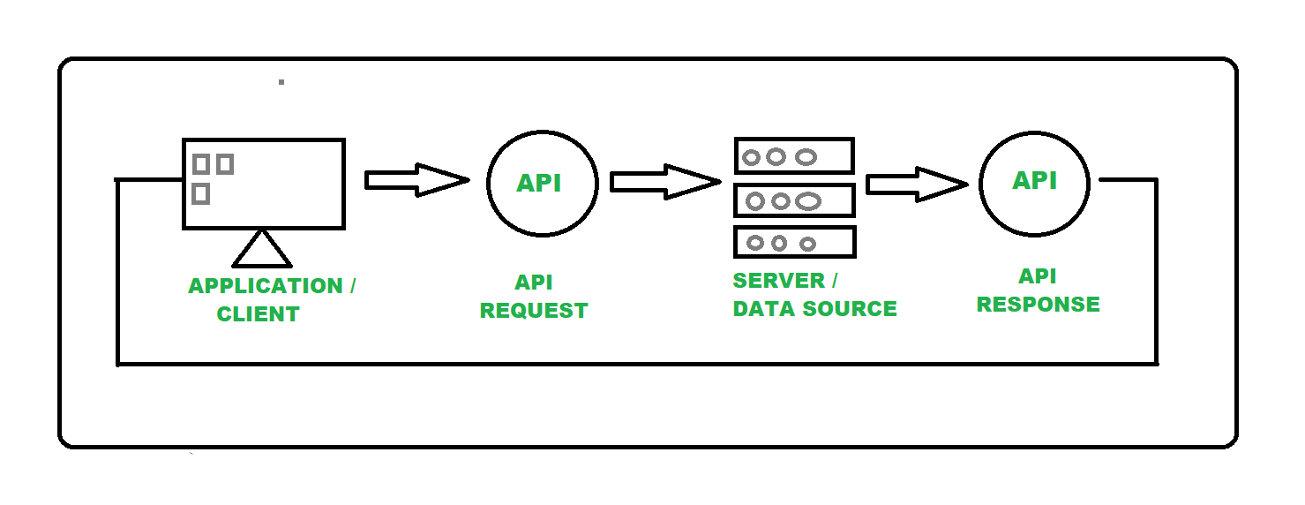
What is API Testing

Slide 7
API Testing using postman
Postman is an application that allows the testing of web APIs. The software was created in 2012 by Abhinav Asthana, Ankit Sobti and Abhijit Kane in Bangalore, India in order to solve the API tests sharing problem. Originally, it was developed as a plugin for Google Chrome, then a rich client, and finally a thin client. It's now used by more than 500,000 companies worldwide. The developer, Postman Inc., originally from India, has its headquarters in San Francisco.^{[2]}

Slide 8
API Testing using postman
Features
Postman regroups API tests in collections, to mutualize their URLs and authentications. It includes:^{[3][4][5][6]}
A free version with workspace sharing to three users maximum.
Variables depending on the selected environment.
A version control system of tests and environments.
Access rights per roles (user or editor).
Benchmarks.
Importation and exportation in JSON.
Tests exportation to various HTTP clients formats (cURL, PHP, Python, Java, Node.js...).
Authentication by JSON Web Token (with possible OAuth2 configuration).
REST, SOAP, GraphQL, and gRPC^{[7]}
A rich client.
A thin client allowing to upload files to send to APIs.
A debugging console which keeps previous requests and responses calls in memory .
Scripts to automatize tests.

Slide 9
API Testing using postman
Step 1 – Download postman
Step 2 – Install postman
Step 3 – Login with gmail/custom sign-in
Step 4 – Click HttpRequest
Step 5 – Carry out tests using post,get,put and delete

Slide 10
Reference
https://www.hypertest.co/api-testing/the-most-comprehensive-how-to-use-postman-guide

